Slide 1


Systems Analysis and Design in a Changing World, Fifth Edition

Slide 2
Learning Objectives
Explain the purpose and various phases of the systems development life cycle (SDLC)‏
Explain when to use an adaptive approach to the SDLC in place of a more predictive traditional SDLC
Explain the differences between a model, a tool, a technique, and a methodology
Describe the two overall approaches used to develop information systems: the traditional method and the object-oriented method
Systems Analysis and Design in a Changing World, 5th Edition

Slide 3
Learning Objectives (continued)‏
Describe the key features of current trends in systems development: the Unified Process (UP), Extreme Programming (XP), and Scrum
Explain how automated tools are used in system development
Systems Analysis and Design in a Changing World, 5th Edition

Slide 4
Overview
System development project
  Planned undertaking with fixed beginning and end
  Produces desired result or product
  Can be a large job with thousands of hours of effort or a small one-month project
Systems Analysis and Design in a Changing World, 5th Edition

Slide 5
The Systems Development Lifecycle (SDLC)‏
Systems development life cycle (SDLC)‏
  Provides overall framework for managing systems development process
Two main approaches to SDLC
  Predictive approach – assumes project can be planned out in advance
  Adaptive approach – more flexible, assumes project cannot be planned out in advance
All projects use some variation of SDLC
Systems Analysis and Design in a Changing World, 5th Edition

Slide 6
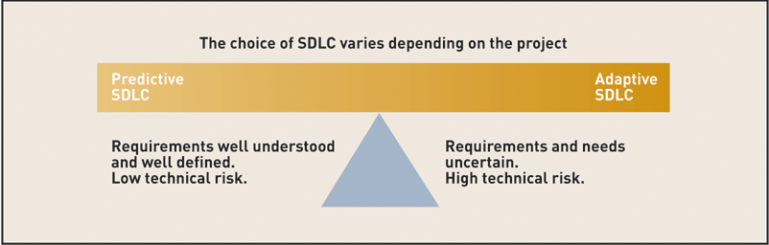
Choosing the Predictive vs. Adaptive Approach to the SDLC
Figure 2-1
Systems Analysis and Design in a Changing World, 5th Edition

Slide 7
Traditional Predictive Approach to the SDLC
Project planning – initiate, ensure feasibility, plan schedule, obtain approval for project
Analysis – understand business needs and processing requirements
Design – define solution system based on requirements and analysis decisions
Implementation – construct, test, train users, and install new system
Support – keep system running and improve
Systems Analysis and Design in a Changing World, 5th Edition

Slide 8
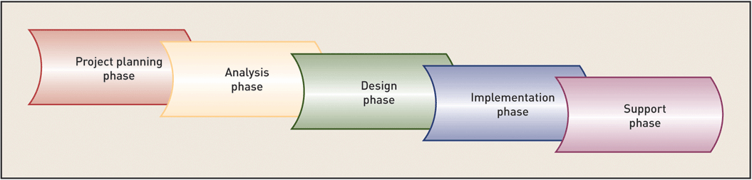
Information System Development Phases
Figure 2-2
Systems Analysis and Design in a Changing World, 5th Edition

Slide 9
SDLC and Problem Solving
Similar to problem-solving approach in Chapter 1
  Organization recognizes problem (project planning)‏
  Project team investigates, understands problem and solution requirements (analysis)‏
  Solution is specified in detail (design)‏
  System that solves problem is built and installed (implementation)‏
  System used, maintained, and enhanced to continue to provide intended benefits (support)‏
Systems Analysis and Design in a Changing World, 5th Edition

Slide 10
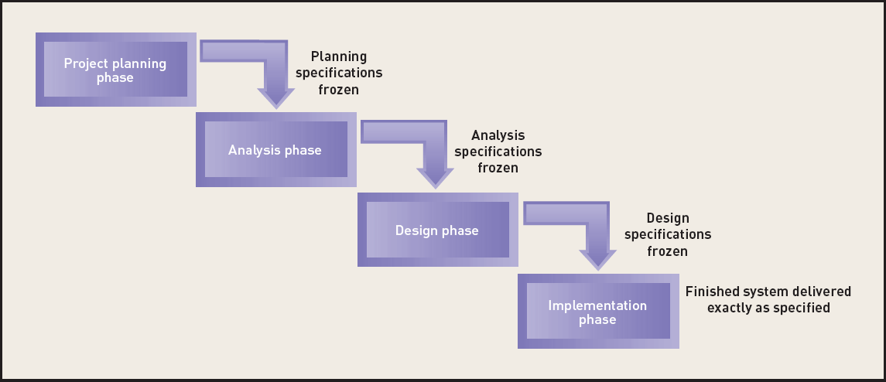
“Waterfall” Approach to the SDLC
Figure 2-4
Systems Analysis and Design in a Changing World, 5th Edition

Slide 11
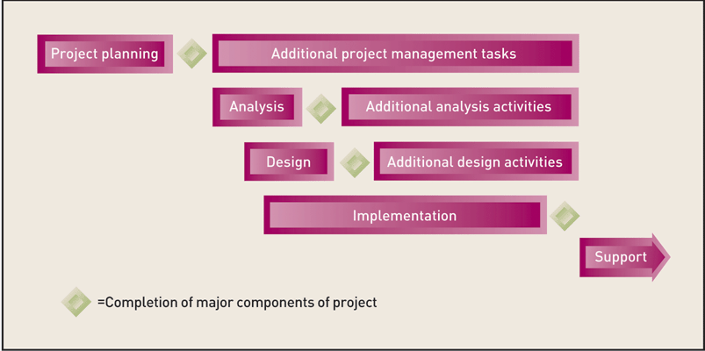
Modified Waterfall Approach with Overlapping Phases
Figure 2-5
Systems Analysis and Design in a Changing World, 5th Edition

Slide 12
Newer Adaptive Approaches to the SDLC
Based on spiral model
  Project cycles through development activities over and over until project is complete
  Prototype created by end of each cycle
  Focuses on mitigating risk
Iteration – Work activities are repeated
  Each iteration refines previous result
  Approach assumes no one gets it right the first time
  There are a series of mini projects for each iteration
Systems Analysis and Design in a Changing World, 5th Edition

Slide 13
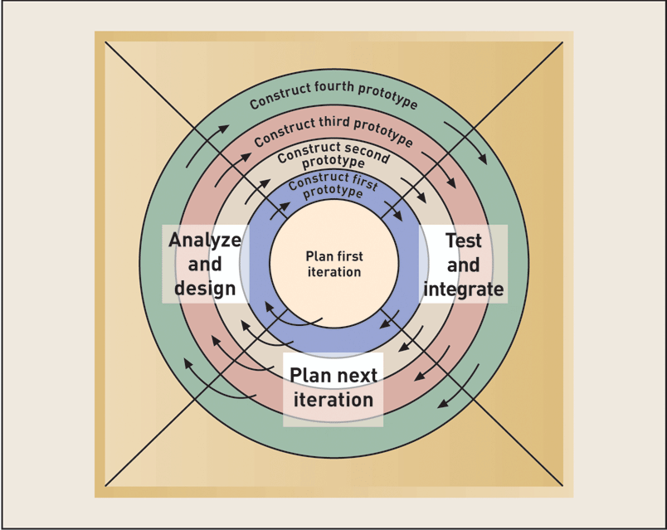
The Spiral Life Cycle Model
Figure 2-6
Systems Analysis and Design in a Changing World, 5th Edition

Slide 14
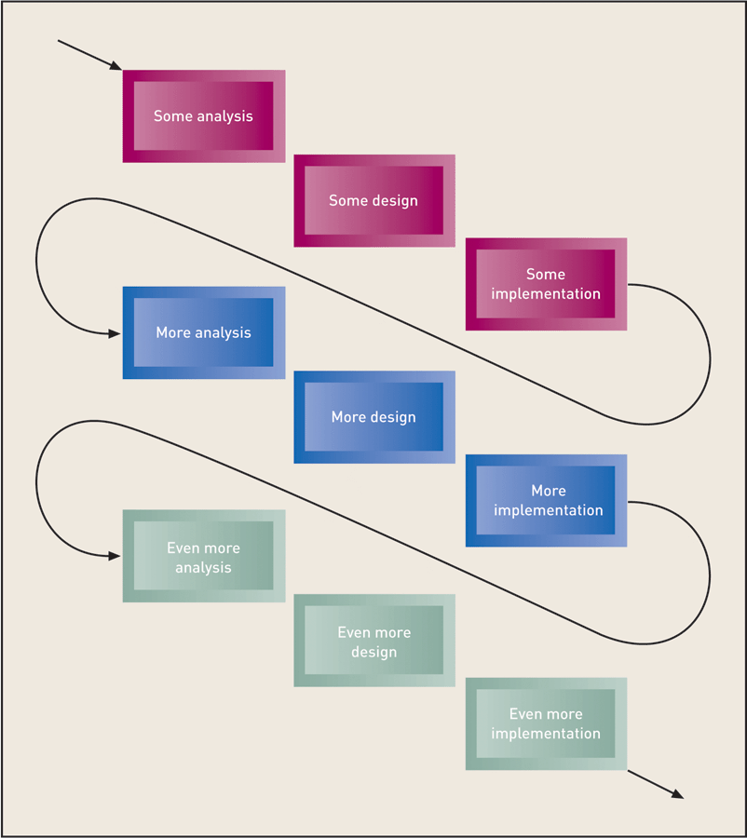
Iteration of System Development Activities
Figure 2-7
Systems Analysis and Design in a Changing World, 5th Edition

Slide 15
Activities of Each SDLC Phase
Predictive or adaptive approach use SDLC
Activities of each “phase” are similar
Phases are not always sequential
Phases can overlap
Activities across phases can be done within an iteration
Systems Analysis and Design in a Changing World, 5th Edition

Slide 16
Activities of Project Planning
Define business problem and scope
Produce detailed project schedule
Confirm project feasibility
  Economic, organizational, technical, resource, and schedule
Staff the project (resource management)‏
Launch project → official announcement
Systems Analysis and Design in a Changing World, 5th Edition

Slide 17
Analysis Activities
Gather information to learn problem domain
Define system requirements
Build prototypes for discovery of requirements
Prioritize requirements
Generate and evaluate alternatives
Review recommendations with management
Systems Analysis and Design in a Changing World, 5th Edition

Slide 18
Design Activities
Design and integrate the network
Design the application architecture
Design the user interfaces
Design the system interfaces
Design and integrate the database
Prototype for design details
Design and integrate system controls
Systems Analysis and Design in a Changing World, 5th Edition

Slide 19
Implementation Activities
Construct software components
Verify and test
Convert data
Train users and document the system
Install the system
Systems Analysis and Design in a Changing World, 5th Edition

Slide 20
Support Activities
Maintain system
  Small patches, repairs, and updates
Enhance system
  Small upgrades or enhancements to expand system capabilities
  Larger enhancements may require separate development project
Support users
  Help desk and/or support team
Systems Analysis and Design in a Changing World, 5th Edition

Slide 21
Methodologies
Methodologies
  Comprehensive guidelines to follow for completing every SDLC activity
  Collection of models, tools, and techniques
Systems Analysis and Design in a Changing World, 5th Edition

Slide 22
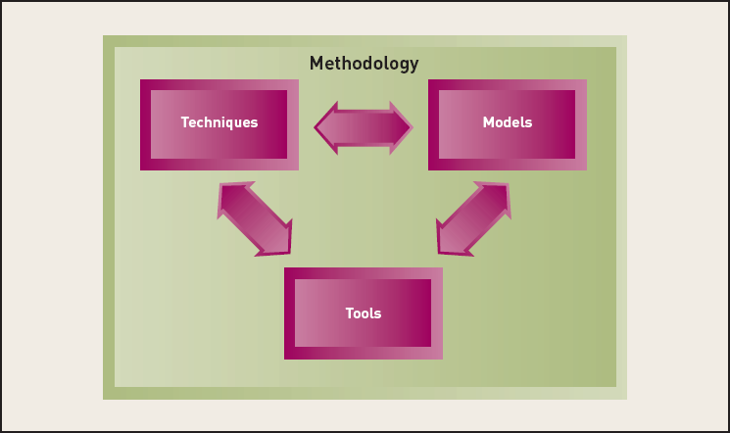
Relationships Among Components of a Methodology
Figure 2-8
Systems Analysis and Design in a Changing World, 5th Edition

Slide 23
Models
Models
  Representation of an important aspect of real world, but not same as real thing
  Abstraction used to separate out aspect
  Diagrams and charts
  Project planning and budgeting aids
Systems Analysis and Design in a Changing World, 5th Edition

Slide 24
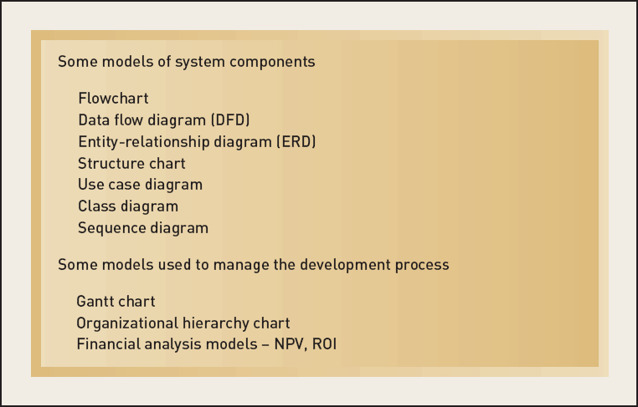
Some Models Used in System Development
Figure 2-9
Systems Analysis and Design in a Changing World, 5th Edition

Slide 25
Tools
Tools
  Software support that helps create models or other required project components
  Range from simple drawing programs to complex CASE tools to project management software
Systems Analysis and Design in a Changing World, 5th Edition

Slide 26
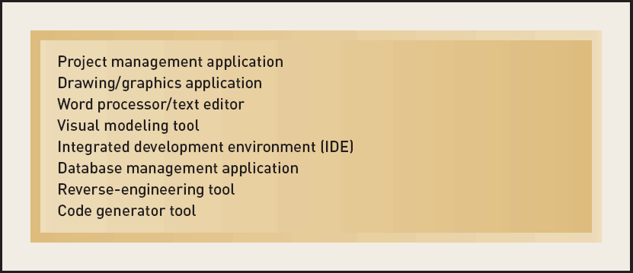
Some Tools Used in System Development
Figure 2-10
Systems Analysis and Design in a Changing World, 5th Edition

Slide 27
Techniques
Techniques
  Collection of guidelines that help analysts complete a system development activity or task
  Can be step-by-step instructions or just general advice
Systems Analysis and Design in a Changing World, 5th Edition

Slide 28
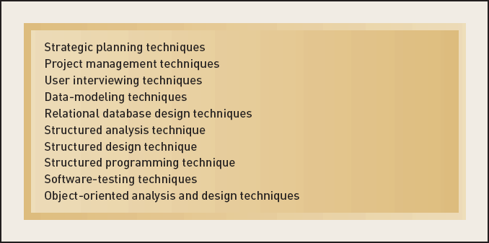
Some Techniques Used in System Development
Figure 2-11
Systems Analysis and Design in a Changing World, 5th Edition

Slide 29
Two Approaches to System Development
Traditional approach
  Also called structured system development
  Structured analysis and design technique (SADT)‏
  Includes information engineering (IE)‏
Object-oriented approach
  Also called OOA, OOD, and OOP
  Views information system as collection of interacting objects that work together to accomplish tasks
Systems Analysis and Design in a Changing World, 5th Edition

Slide 30
Traditional Approach
Structured programming
  Improves computer program quality
  Allows other programmers to easily read and modify code
  Each program module has one beginning and one ending
  Three programming constructs (sequence, decision, repetition)‏
Systems Analysis and Design in a Changing World, 5th Edition

Slide 31
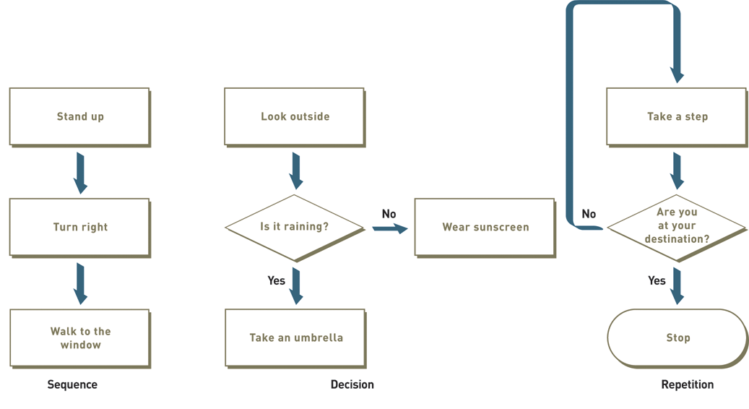
Three Structured Programming Constructs
Figure 2-12
Systems Analysis and Design in a Changing World, 5th Edition

Slide 32
Top-Down Programming
Divides complex programs into hierarchy of modules
The module at top controls execution by “calling” lower level modules
Modular programming
  Similar to top-down programming
One program calls other programs to work together as single system
Systems Analysis and Design in a Changing World, 5th Edition

Slide 33
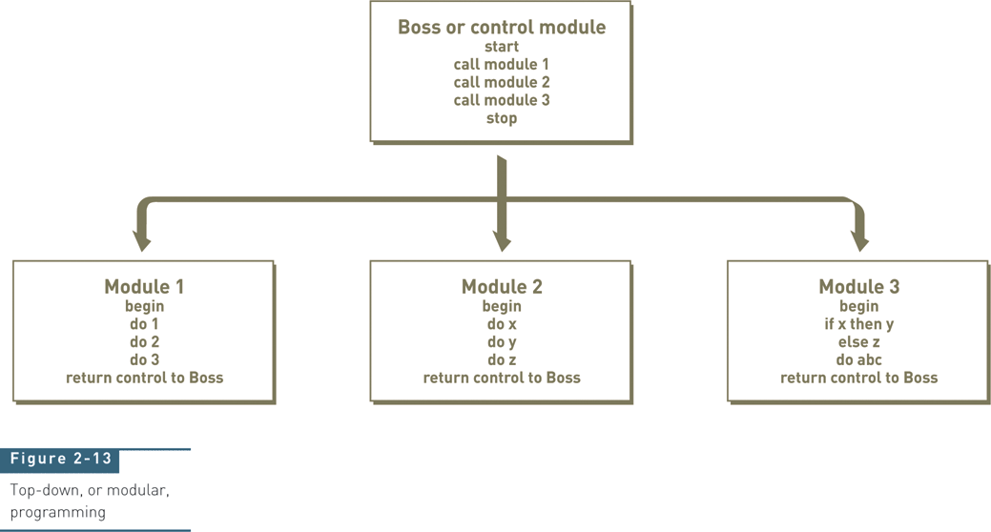
Top-Down or Modular Programming
Figure 2-13
Systems Analysis and Design in a Changing World, 5th Edition

Slide 34
Structured Design
Technique developed to provide design guidelines
  What set of programs should be
  What program should accomplish
  How programs should be organized into a hierarchy
Modules are shown with structure chart
Main principle of program modules
  Loosely coupled – module is independent of other modules
  Highly cohesive – module has one clear task
Systems Analysis and Design in a Changing World, 5th Edition

Slide 35
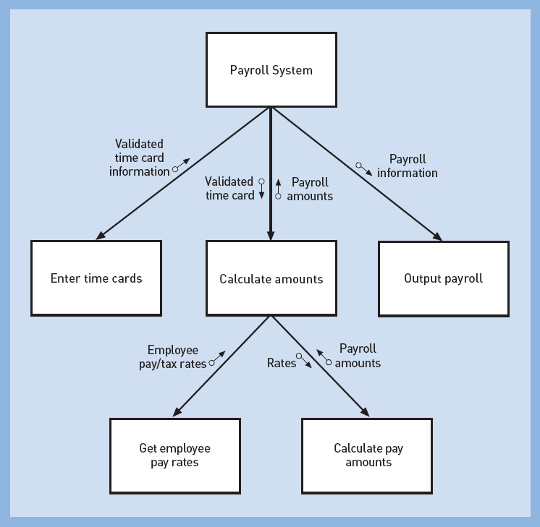
Structure Chart Created Using
Structured Design Technique
Figure 2-14
Systems Analysis and Design in a Changing World, 5th Edition

Slide 36
Structured Analysis
Define what system needs to do (processing requirements)‏
Define data system needs to store and use (data requirements)‏
Define inputs and outputs
Define how functions work together to accomplish tasks
Data flow diagrams (DFD) and entity relationship diagrams (ERD) show results of structured analysis
Systems Analysis and Design in a Changing World, 5th Edition

Slide 37
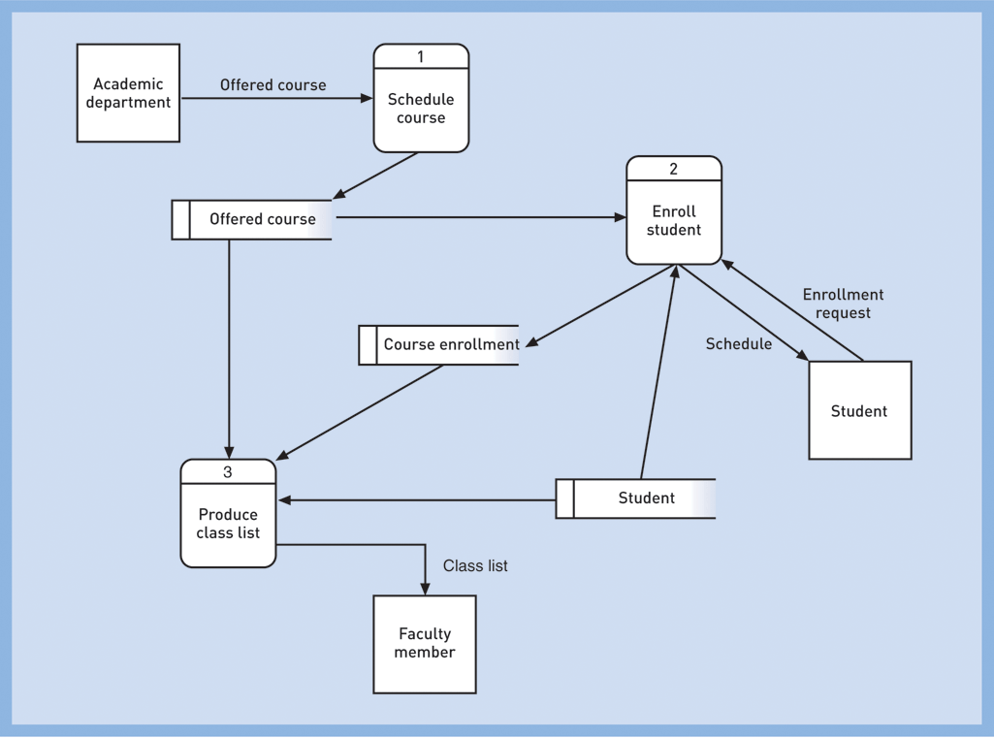
Data Flow Diagram (DFD) Created Using Structured Analysis Technique
Figure 2-15
Systems Analysis and Design in a Changing World, 5th Edition

Slide 38
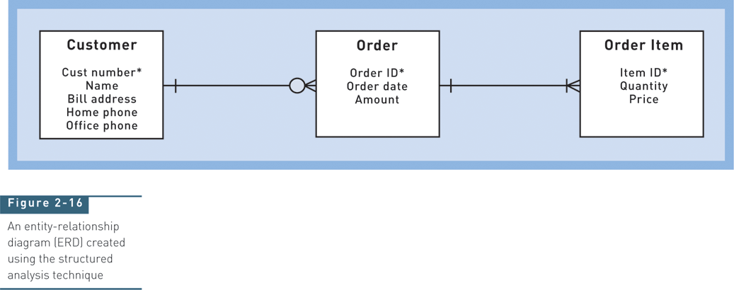
Entity-Relationship Diagram (ERD) Created Using Structured Analysis Technique
Figure 2-16
Systems Analysis and Design in a Changing World, 5th Edition

Slide 39
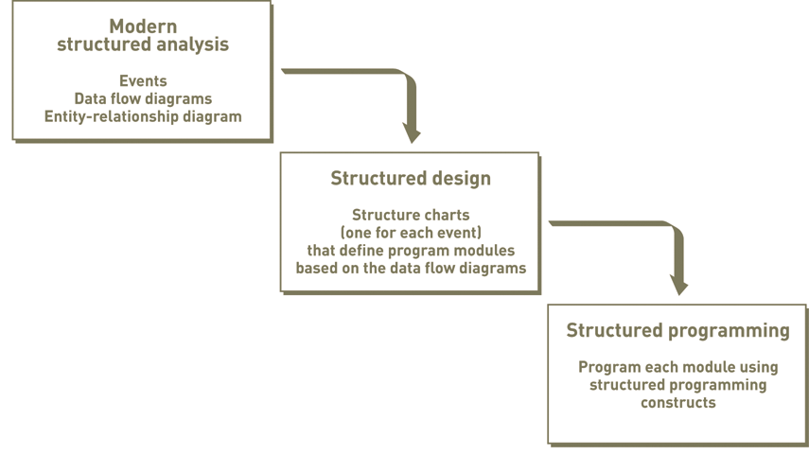
Structured Analysis Leads to Structured Design and Structured Programming
Figure 2-17
Systems Analysis and Design in a Changing World, 5th Edition

Slide 40
Information Engineering (IE)‏
Refinement to structured development
Methodology with strategic planning, data modeling, automated tools focus
More rigorous and complete than SADT
Industry merged key concepts from structured development and information engineering approaches into traditional approach
Systems Analysis and Design in a Changing World, 5th Edition

Slide 41
Object-Oriented Approach
Completely different approach to information systems
Views information system as collection of interacting objects that work together to accomplish tasks
  Objects – things in computer system that can respond to messages
  Conceptually, no processes, programs, data entities, or files are defined – just objects
OO languages: Java, C++, C# .NET, VB .NET
Systems Analysis and Design in a Changing World, 5th Edition

Slide 42
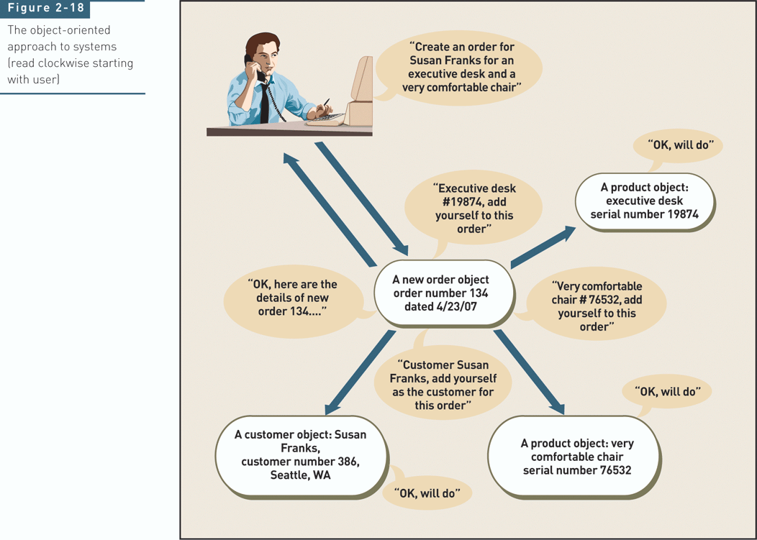
Object-Oriented Approach to Systems
Figure 2-18
Systems Analysis and Design in a Changing World, 5th Edition

Slide 43
Object-Oriented Approach (continued)‏
Object-oriented analysis (OOA)‏
  Defines types of objects users deal with
  Shows use cases are required to complete tasks
Object-oriented design (OOD)‏
  Defines object types needed to communicate with people and devices in system
  Shows how objects interact to complete tasks
  Refines each type of object for implementation with specific language of environment
Systems Analysis and Design in a Changing World, 5th Edition

Slide 44
Object-Oriented Approach (continued)‏
Object-oriented programming (OOP)‏
  Writing statements in programming language to define what each type of object does
Systems Analysis and Design in a Changing World, 5th Edition

Slide 45
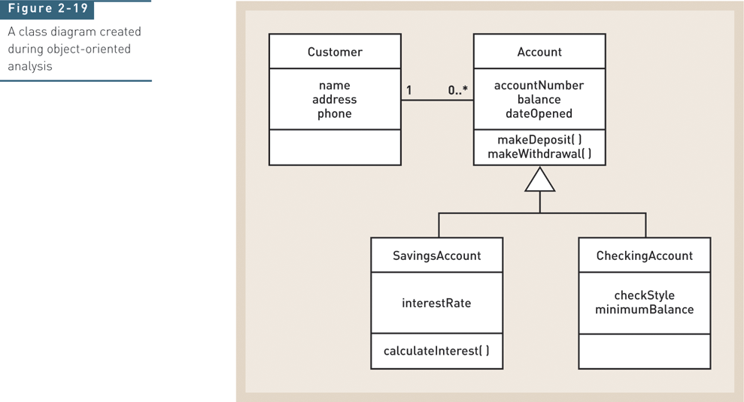
Class Diagram Created During OO Analysis
Figure 2-19
Systems Analysis and Design in a Changing World, 5th Edition

Slide 46
SDLC Variations
Many variations of SDLC in practice
  Based on variation of names for phases
  No matter which one, activities/tasks are similar
Some increase emphasis on people
  User-centered design, participatory design
  Sociotechnical systems
Some increase speed of development
  Rapid application development (RAD)‏
  Prototyping
Systems Analysis and Design in a Changing World, 5th Edition

Slide 47
Current Trends in Development
More adaptive approaches
  The Unified Process (UP)‏
  Extreme Programming (XP)‏
  Scrum
Details on each in Chapter 17
Systems Analysis and Design in a Changing World, 5th Edition

Slide 48
The Unified Process (UP)‏
Object-oriented development approach
Offered by IBM / Rational
  Booch, Rumbaugh, Jacobson
Unified Modeling Language (UML) used primarily for modeling
UML can be used with any OO methodology
UP defines four life cycle phases
  Inception, elaboration, construction, transition
Systems Analysis and Design in a Changing World, 5th Edition

Slide 49
The Unified Process (UP) (continued)‏
Reinforces six best practices
  Develop iteratively
  Define and manage system requirements
  Use component architectures
  Create visual models
  Verify quality
  Control changes
Systems Analysis and Design in a Changing World, 5th Edition

Slide 50
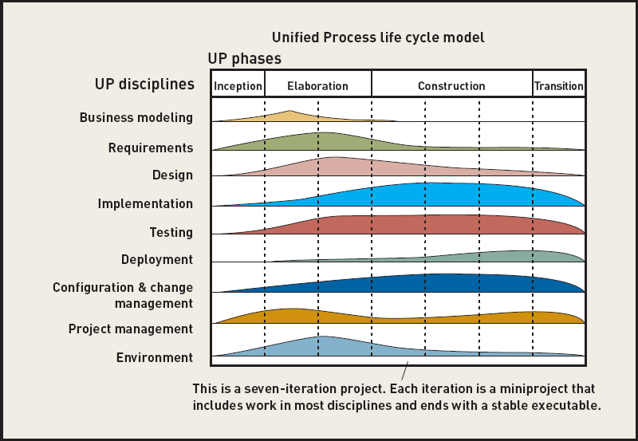
Unified Process Life Cycle
Figure 2-20
Systems Analysis and Design in a Changing World, 5th Edition

Slide 51
Extreme Programming (XP)‏
Recent, lightweight, development approach to keep process simple and efficient
Describes system support needed and required system functionality through informal user stories
Has users describe acceptance tests to demonstrate defined outcomes
Relies on continuous testing and integration, heavy user involvement, programming done by small teams
Systems Analysis and Design in a Changing World, 5th Edition

Slide 52
Scrum
For highly adaptive project needs
Respond to situation as rapidly as possible
Scrum refers to rugby game
  Both are quick, agile, and self-organizing
Team retains control over project
Values individuals over processes
Systems Analysis and Design in a Changing World, 5th Edition

Slide 53
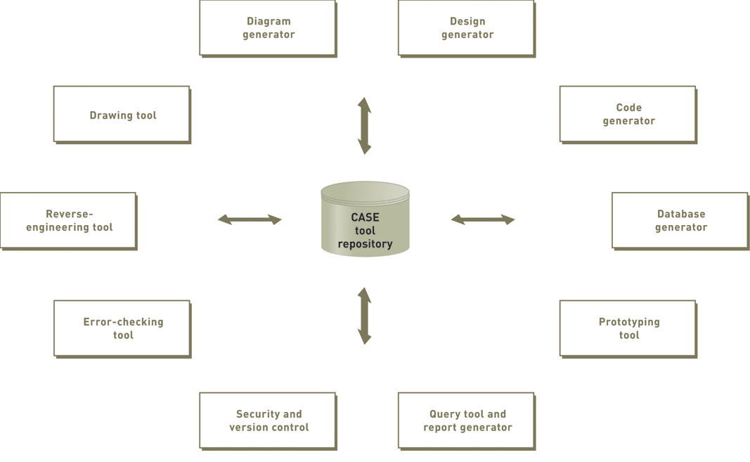
Visual Modeling Tool Repository Contains All System Information
Figure 2-21
Systems Analysis and Design in a Changing World, 5th Edition

Slide 54
Summary
System development projects are organized around the systems development life cycle (SDLC)
Some projects use a predictive approach to the SDLC, and others use a more adaptive approach to the SDLC
SDLC phases include project planning, analysis, design, implementation, and support
In practice, phases overlap, and projects contain many iterations of analysis, design, and implementation
Systems Analysis and Design in a Changing World, 5th Edition

Slide 55
Summary (continued)‏
Models, techniques, and tools make up a system development methodology
System development methodology provides guidelines to complete every activity in the SDLC
System development methodologies are based on traditional approach or object-oriented approach
Current trends include: Extreme Programming (XP), Unified Process (UP), and Scrum
Visual Modeling tools are designed to help analysts complete system development tasks
Systems Analysis and Design in a Changing World, 5th Edition

